Slide 1

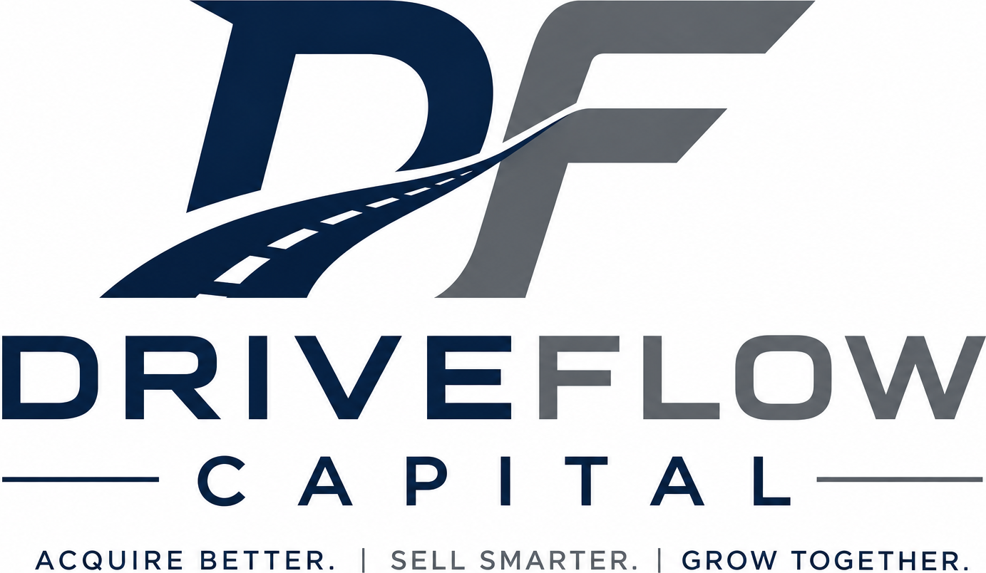
Technology-Enabled Automotive Asset Acquisition
We deploy capital into undervalued automotive assets using a proprietary acquisition process, advanced sourcing technology, and proven acquisition expertise.
Seeking $150,000 Initial Growth Capital
Data-Driven Acquisitions. Proven Execution. Consistent Returns.
Private Investment Opportunity | Not an Offer to Sell Securities

Slide 2
Core Positioning
Technology-enabled automotive asset acquisition
DriveFlow Capital deploys capital into undervalued vehicle assets, turning private-market inefficiency into repeatable acquisition returns.
01
02
03
Data-Driven Sourcing
Proven Execution
Rapid Capital Recycling
Advanced technology identifies undervalued listings before traditional buyers react.
Over four decades of automotive experience informs every acquisition decision.
Inventory is acquired, sold, and redeployed through a 7–21 day target turnover model.
Investor thesis: tangible vehicle assets + technology-enabled sourcing + operator-led execution.
DriveFlow Capital | Private Investment Opportunity | Not an Offer to Sell Securities
02

Slide 3
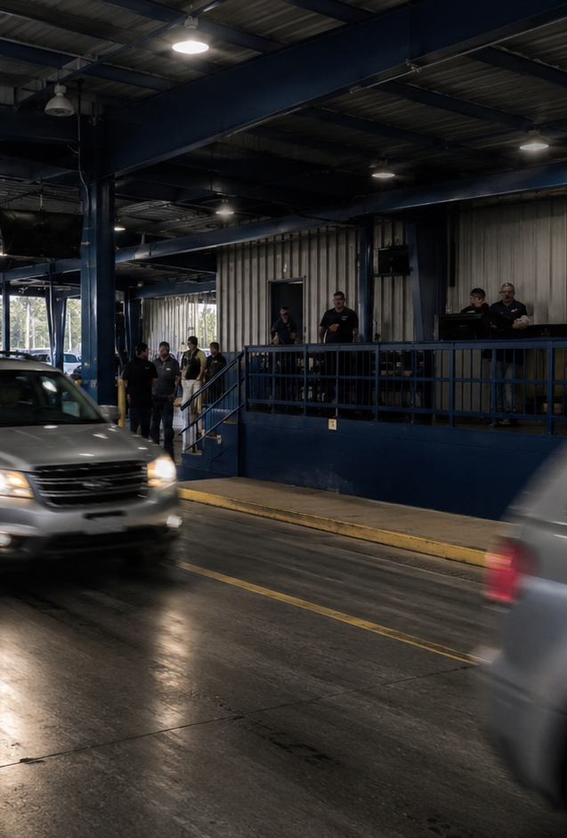
The Market Problem
Auction dependency is compressing margins
Traditional acquisition channels have become crowded, expensive, and difficult to scale profitably.
•
Large dealer groups and institutional buyers bid up auction prices
•
Acquisition margins compress across traditional wholesale channels
•
Independent operators are forced to compete on price instead of speed
•
The best inventory is often already gone before most buyers see it
Auction prices rising
Margins compressing
Speed wins
DriveFlow Capital | Private Investment Opportunity
03

Slide 4
The Opportunity
Private-party markets remain inefficient
Private sellers still create mispriced opportunities every day — but speed, underwriting, and seller engagement determine who captures them.
Facebook Marketplace
Craigslist
OfferUp
Local Classifieds
Urgent sale
Pricing gap
Convenience seller
Fragmented supply
1
2
3
4
5
Listings appear
AI flags value
Operator evaluates
Seller contacted
Vehicle acquired
The opportunity is not just access. The opportunity is speed + execution.
DriveFlow Capital | Private Investment Opportunity | Not an Offer to Sell Securities
04

Slide 5

Our Solution
Advanced sourcing technology + proprietary acquisition discipline
DriveFlow turns online listing chaos into a repeatable acquisition pipeline.
Detect
Evaluate
Acquire
Resell
Recycle
Real-time marketplace monitoring
Margin, title, demand, and condition screen
Fast seller engagement and negotiation
Wholesale auctions and dealer channels
Capital redeployed into the next cycle
Process: Detect → Evaluate → Acquire → Resell → Recycle Capital
DriveFlow Capital | Private Investment Opportunity | Not an Offer to Sell Securities
05

Slide 6
Why DriveFlow Wins
Execution is the moat
Most buyers can search listings. Few can consistently turn those listings into profitable transactions.
Traditional Dealers
Tech Platforms
DriveFlow Capital
• Auction-dependent
• Data-only
• Direct sourcing + execution
• Slower private-party response
• No capital deployment
• Fast acquisition discipline
• Compete on price
• No operator execution
• Proven resale channels
Core advantage: knowing which opportunities to buy, and moving before competitors do.
DriveFlow Capital | Private Investment Opportunity | Not an Offer to Sell Securities
06

Slide 7
Acquisition Funnel
From marketplace data to cash conversion
10,000+
Listings monitored
1,000+
Qualified opportunities
200–300
Seller conversations
180
Year-one acquisitions target
100%
Wholesale exit focus
Technology expands the top of the funnel. Experience improves bottom-of-funnel conversion.
DriveFlow Capital | Private Investment Opportunity | Not an Offer to Sell Securities
07

Slide 8
Unit Economics
Profit is created at acquisition
$1,250
7–21 days
180 vehicles
$225K
Average gross profit per vehicle
Target hold time
Year-one acquisition target
Year-one gross profit target
Cash cycle
Buy below market
Wholesale exit
Redeploy capital
The model is designed around disciplined purchase criteria, rapid disposition, and continuous capital recycling.
DriveFlow Capital | Private Investment Opportunity | Not an Offer to Sell Securities
08

Slide 9
Growth Plan
Conservative ramp with upside run-rate
Phase 3 annualized potential: 45 vehicles/mo × 12 × $1,250 = $675,000 gross profit
Base-case year-one target
180
Growth is driven by additional market coverage, faster seller response, and greater working capital capacity.
vehicles acquired in Year 1
45 / mo
$225K
25 / mo
gross profit at $1,250/unit
15 / mo
Phase 1
Phase 2
Phase 3
Launch
Expansion
Target run-rate
DriveFlow Capital | Private Investment Opportunity | Not an Offer to Sell Securities
09

Slide 10
Investment Structure
Simple, asset-backed, and aligned
Seeking $150,000 initial growth capital
10%
$50
16%
180
Annual return on capital
Per vehicle acquired
Estimated Year-One cash yield
Year-One vehicle target
Year-one return illustration
$150,000 investment → $15,000 annual return + $9,000 performance payment = $24,000 total return
Based on 180 vehicles acquired during Year One.
DriveFlow Capital | Private Investment Opportunity | Not an Offer to Sell Securities
10

Slide 11
Use of Funds
Lean capital deployment focused on inventory
90%
90% Vehicle Acquisition Capital
7% AI & Marketplace Tools
The majority of investor capital is deployed directly into tangible vehicle inventory to maximize purchasing power and turnover.
Subscriptions, valuation tools, lead monitoring, workflow automation, and acquisition intelligence.
3% Transportation & Logistics
Vehicle movement, auction delivery, title workflow, and related transaction logistics.
DriveFlow Capital | Private Investment Opportunity | Not an Offer to Sell Securities
11

Slide 12
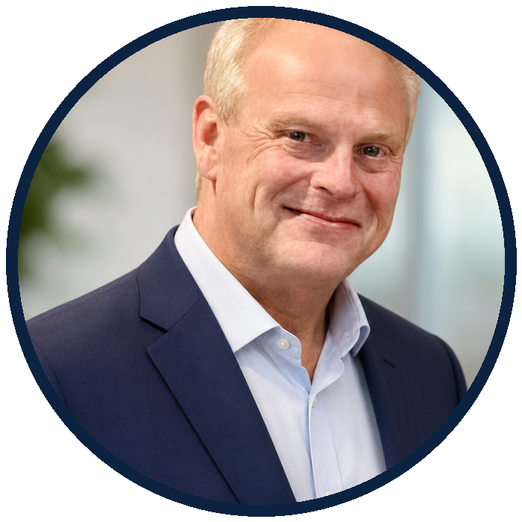

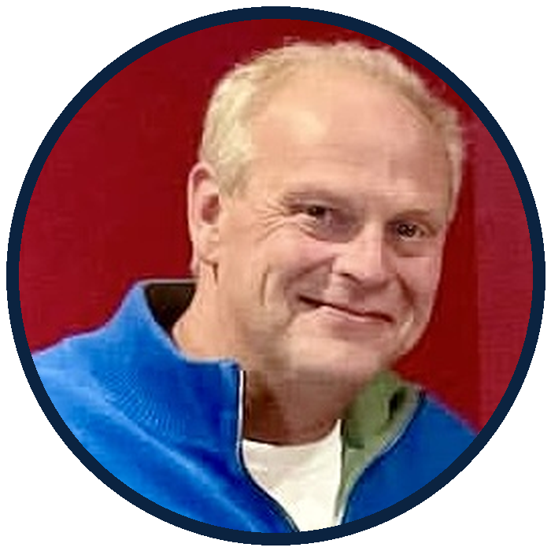
Leadership
Operator-led, not theory-led
Travis DeLoney
35 years in automotive acquisition, valuation, dealer operations, and wholesale remarketing.
Founder Story
We’ve adapted through every sourcing shift — newspapers, Craigslist, Facebook Marketplace, and now AI-enabled acquisition.
Ashley worked side by side with Travis for 5 years before leaving Alaska to open her dealership in Tempe, Arizona.
Ashley DeLoney
Tempe, Arizona dealer principal with seven years of used car dealership ownership and full-cycle acquisition experience.
Technology accelerates discovery.
Experience determines profit.
DriveFlow Capital | Private Investment Opportunity | Not an Offer to Sell Securities
12

Slide 13
DriveFlow Capital
Data-Driven Acquisitions. Proven Execution. Consistent Returns.
We deploy capital into undervalued automotive assets using disciplined acquisition criteria, advanced sourcing technology, and proven operator expertise.
Acquire below market. Turn inventory quickly. Recycle capital efficiently.
Travis DeLoney & Ashley DeLoney | 689-688-9311 | travis@driveflowcapital.com
DriveFlow Capital | Private Investment Opportunity | Not an Offer to Sell Securities
13

